Slide 1
SINGLE-SOURCE SHORTEST PATHS

Slide 2
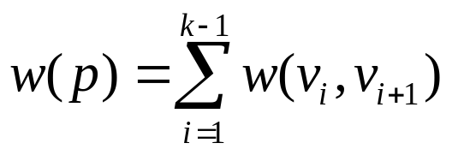
Introduction
Generalization of BFS to handle weighted graphs
Direct Graph G = ( V, E ), edge weight fn ; w : E → R
In BFS w(e)=1 for all e  E
Weight of path p = v₁ → v₂ → … → v_{k} is

Slide 3
Shortest Path
Shortest Path = Path of minimum weight
δ(u,v)=
p
min{ω(p) : u v}; if there is a path from u to v,
∞ otherwise.

Slide 4
Shortest-Path Variants
Shortest-Path problems
  Single-source shortest-paths problem: Find the shortest path from s to each vertex v. (e.g. BFS)
  Single-destination shortest-paths problem: Find a shortest path to a given destination vertex t from each vertex v.
  Single-pair shortest-path problem: Find a shortest path from u to v for given vertices u and v.
  All-pairs shortest-paths problem: Find a shortest path from u to v for every pair of vertices u and v.

Slide 5
Optimal Substructure Property
Theorem: Subpaths of shortest paths are also shortest paths
Let P_{1k} = <v₁, ... ,v_{k} > be a shortest path from v₁ to v_{k}
Let P_{ij} = <v_{i}, ... ,v_{j} > be subpath of P_{1k} from v_{i} to v_{j}
for any i, j
Then P_{ij} is a shortest path from v_{i} to v_{j}

Slide 6
Optimal Substructure Property
Proof: By cut and paste
If some subpath were not a shortest path
We could substitute a shorter subpath to create a shorter total path
Hence, the original path would not be shortest path
v₀
v₁
v₂
v₃
v₄
v₅
v₆
v₇

Slide 7
Optimal Substructure Property
Definition:
δ(u,v) = weight of the shortest path(s) from u to v
Well Definedness:
negative-weight cycle in graph: Some shortest paths may not be defined
argument:can always get a shorter path by going around the cycle again
χψχλε
< 0
σ
ϖ

Slide 8
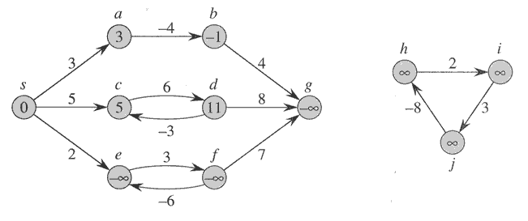
Negative-weight edges
No problem, as long as no negative-weight cycles are reachable from the source
Otherwise, we can just keep going around it, and
get w(s, v) = −∞ for all v on the cycle.

Slide 9
Triangle Inequality
Lemma 1: for a given vertex s  V and for every edge (u,v)  E,
δ(s,v) ≤ δ(s,u) + w(u,v)
Proof: shortest path s v is no longer than any other path.
in particular the path that takes the shortest path s v and
then takes cycle (u,v)
υ
ϖ
σ

Slide 10
Relaxation
Maintain d[v] for each v  V
d[v] is called shortest-path weight estimate
and it is upper bound on δ(s,v)
INIT(G, s)
for each v ∈ V do
d[v] ← ∞
π[v] ← NIL
d[s] ← 0

Slide 11
Relaxation
RELAX(u, v)
if d[v] > d[u]+w(u,v) then
d[v] ← d[u]+w(u,v)
π[v] ← u
u
v
u
v
2
2
5
9
5
6
Relax(u,v)
5
7
5
6
2
2
u
v
u
v

Slide 12
Properties of Relaxation
Algorithms differ in
how many times they relax each edge, and
the order in which they relax edges
Question: How many times each edge is relaxed in BFS?
Answer: Only once!

Slide 13
Properties of Relaxation
Given:
An edge weighted directed graph G = ( V, E ) with edge weight function (w:E → R) and a source vertex s  V
G is initialized by INIT( G , s )
Lemma 2: Immediately after relaxing edge (u,v),
d[v] ≤ d[u] +w(u,v)
Lemma 3: For any sequence of relaxation steps over E,
(a) the invariant d[v] ≥ δ(s,v) is maintained
(b) once d[v] achieves its lower bound, it never changes.

Slide 14
Properties of Relaxation
Proof of (a): certainly true after
INIT(G,s) : d[s] = 0 = δ(s,s):d[v] = ∞ ≥ δ(s,v) ∀ v∈ V-{s}
Proof by contradiction:Let v be the first vertex for which
RELAX(u, v) causes d[v] < δ(s, v)
After RELAX(u , v) we have
  d[u] + w(u,v) = d[v] < δ(s, v)
≤ δ(s, u) + w(u,v) by L1
  d[u]+w(u,v) < δ(s, u) + w(u, v) => d[u] < δ(s, u)
  contradicting the assumption

Slide 15
Properties of Relaxation
Proof of (b):
d[v] cannot decrease after achieving its lower bound;
because d[v] ≥ δ(s,v)
d[v] cannot increase since relaxations don’t increase d values.

Slide 16
Properties of Relaxation
C1 : For any vertex v which is not reachable from s, we have
invariant d[v] = δ(s,v) that is maintained over any sequence of
relaxations
Proof: By L3(b), we always have ∞ = δ(s,v) ≤ d[v]
=> d[v] = ∞ = δ(s,v)

Slide 17
Properties of Relaxation
  Lemma 4: Let s u →v be a shortest path from s to v for some u,v  V
  Suppose that a sequence of relaxations including
  RELAX(u,v) were performed on E
  If d[u] = δ(s, u) at any time prior to RELAX(u, v)
  then d[v] = δ(s, v) at all times after RELAX(u, v)

Slide 18
Properties of Relaxation
Proof: If d[u] = δ(s, v) prior to RELAX(u, v)
d[u] = δ(s, v) hold thereafter by L3(b)
After RELAX(u,v), we have d[v] ≤ d[u] + w(u, v) by L2
= δ(s, u) + w(u, v) hypothesis
= δ(s, u) by optimal subst.property
Thus d[v] ≤ δ(s, v)
But d[v] ≥ δ(s, v) by L3(a) => d[v] = δ(s, v)
Q.E.D.

Slide 19
Single-Source Shortest Paths in DAGs
Shortest paths are always well-defined in dags
    no cycles => no negative-weight cycles even if there are negative-weight edges
Idea: If we were lucky
    To process vertices on each shortest path from left to right, we would be done in 1 pass due to L4

Slide 20
Single-Source Shortest Paths in DAGs
In a dag:
Every path is a subsequence of the topologically sorted
vertex order
If we do topological sort and process vertices in that order
We will process each path in forward order
  Never relax edges out of a vertex until have processed all edges into the vertex
Thus, just 1 pass is sufficient

Slide 21
Single-Source Shortest Paths in DAGs
DAG-SHORTEST PATHS(G, s)
TOPOLOGICALLY-SORT the vertices of G
INIT(G, s)
for each vertex u taken in topologically sorted order do
for each v  Adj[u] do
RELAX(u, v)

Slide 22
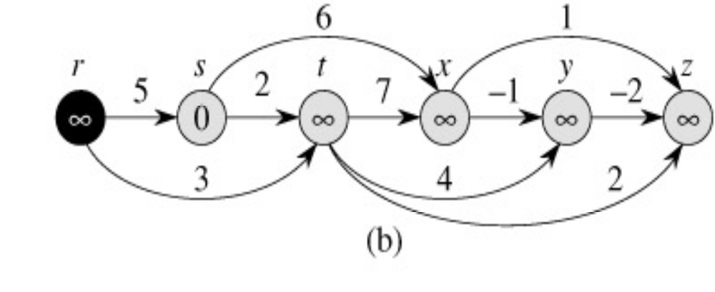
Example

Slide 23
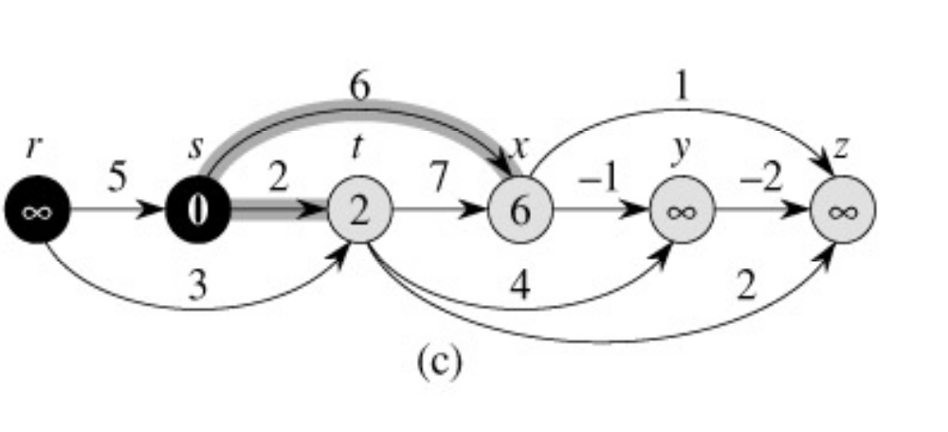
Example

Slide 24
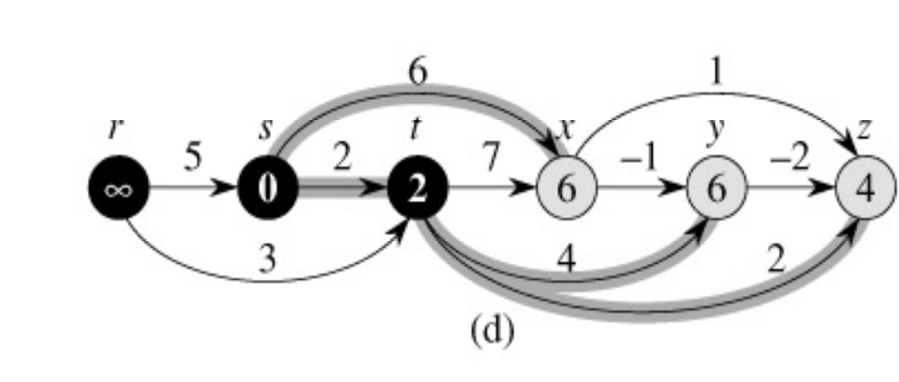
Example

Slide 25
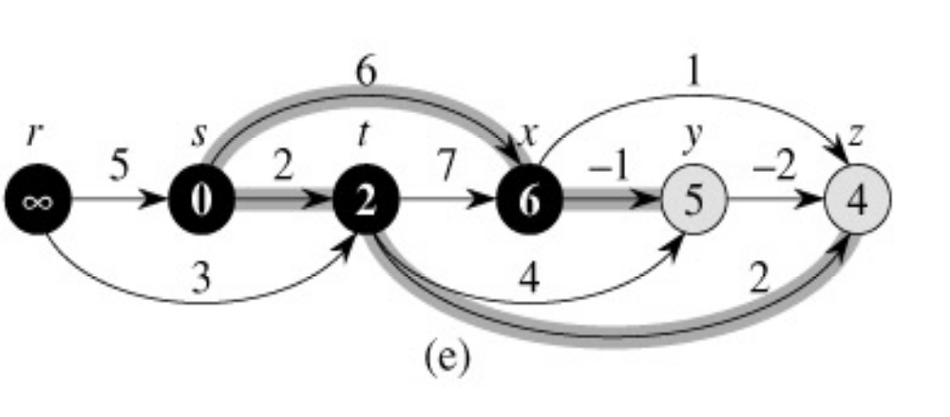
Example

Slide 26
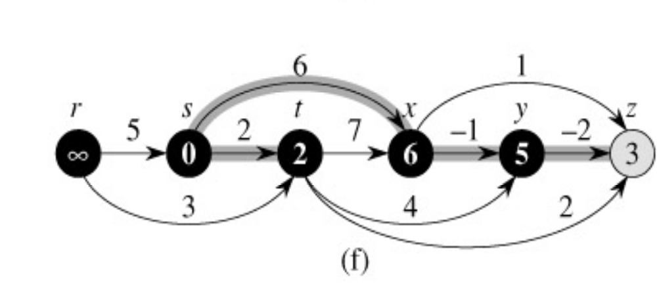
Example

Slide 27
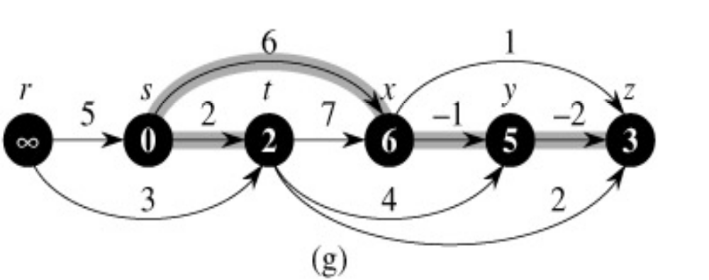
Example

Slide 28
Single-Source Shortest Paths in DAGs
Runs in linear time: Θ(V+E)
topological sort: Θ(V+E)
initialization: Θ(V+E)
for-loop: Θ(V+E)
each vertex processed exactly once
each edge processed exactly once: => Θ(V+E)

Slide 29
Single-Source Shortest Paths in DAGs
Thm: (Correctness of DAG-SHORTEST-PATHS):
At termination of DAG-SHORTEST-PATHS procedure
d[v] = δ(s, v) for all v  V

Slide 30
Single-Source Shortest Paths in DAGs
Α
Proof: If v ∉ Rs , then d[v] = δ(s, v)
If v ∉ Rs , so a shortest path
p = <v₀=s, v₁, v₂, …,v_{k}=v>
Because we process vertices in topologically sorted order
  Edges on p are relaxed in the order
(u0, u1),(u1, u2),...,(uk-1, uk)
A simple induction on k using L4 shows that
  d[vi] = δ(s, v) at termination for i = 0,1,2,...,k
ϖ  V
E

Slide 31
Dijkstra’s Algorithm For Shortest Paths
Non-negative edge weight
Like BFS: If all edge weights are equal, then use BFS, otherwise use this algorithm
Use Q = priority queue keyed on d[v] values
(note: BFS uses FIFO)

Slide 32
Dijkstra’s Algorithm For Shortest Paths
DIJKSTRA(G, s)
INIT(G, s)
S←Ø > set of discovered nodes
Q←V[G]
while Q ≠Ø do
u←EXTRACT-MIN(Q)
S←S U {u}
for each v  Adj[u] do
RELAX(u, v) > May cause
> DECREASE-KEY(Q, v, d[v])

Slide 33
Example
u
v
∞
1
∞
10
0
2
3
9
s
4
6
7
5
∞
∞
2
x
y

Slide 34
Example
u
v
10
1
∞
10
9
0
2
3
s
4
6
7
5
5
∞
2
x
y

Slide 35
Example
u
v
8
1
14
10
0
2
3
9
s
4
6
7
5
5
7
2
x
y

Slide 36
Example
u
v
8
1
13
10
2
3
9
s
0
4
6
7
5
5
7
2
x
y

Slide 37
Example
u
v
8
1
9
10
0
2
3
9
s
4
6
7
5
5
7
2
x
y

Slide 38
Example
u
v
8
1
9
10
2
3
9
0
4
6
s
7
5
5
7
2
x
y

Slide 39
Dijkstra’s Algorithm For Shortest Paths
Observe :
Each vertex is extracted from Q and inserted into S
exactly once
Each edge is relaxed exactly once
S = set of vertices whose final shortest paths have already been determined
  i.e. , S = {v  V: d[v] = δ(s, v) ≠ ∞ }

Slide 40
Dijkstra’s Algorithm For Shortest Paths
Similar to BFS algorithm: S corresponds to the set of black vertices in BFS which have their correct breadth-first distances already computed
Greedy strategy: Always chooses the closest(lightest) vertex in Q = V-S to insert into S
Relaxation may reset d[v] values thus updating
Q = DECREASE-KEY operation.

Slide 41
Dijkstra’s Algorithm For Shortest Paths
Example: Run algorithm on a sample graph
∞ 10 9 8
10
2
0
s
∞ 6
3
4
5
1
∞ 5

Slide 42
Correctness of Dijkstra’s Algorithm
Thm: At termination of Dijkstra’s algorithm
d[u] = δ(s, u) ∀ u ∈ V
Proof: Trivial for u ∉ Rs since d[u] = ∞ = δ(s, u)
Proof: By contradiction for u  Rs
Let u be the first vertex for which d[u] ≠ δ(s, u) when it is
inserted to S
d[u] > δ(s, u) since d[v] ≥ δ(s, v) ∀ v ∈ V by L3(a)
Consider an actual shortest path p from s  S to
u  Q = V-S

Slide 43
Correctness of Dijkstra’s Algorithm
Let y be first vertex along p such that y  V-S
Let x  V be y’s predecessor along p
Thus p can be decomposed as s x→y u
Claim: d[y] = δ(s, y) when u was selected from Q for insertion into S
Observe that x ∉ S by assumption on y
d[x] = δ(s, x) by assumption on u being first vertex in S for which d[u] ≠ δ(s, u)
p1
p2

Slide 44
Correctness of Dijkstra’s Algorithm
x  S => x is already processed => edge (x, y) is already
relaxed => d[y] = δ(s, y) by L4 & optimal subst. property
P2
u
s
x
y
P1

Slide 45
Correctness of Dijkstra’s Algorithm
d[u] > δ(s, u)
= δ(s, y) + w(p2) by optimal substructure Thm
= d[y] + w(p2) by the above claim
≥ d[y] due to non-negative edge-weight assumption
d[u] > d[y] => algorithm would have chosen y to
process next, not u.Contradiction
P2
u
s
x
y
P1

Slide 46

Correctness of Dijkstra’s Algorithm
Figure about the proof:
P₂
u
s
x
y
P₁
S
vertices x&y are distinct, but may have s=x and/or y=u
path P₂ may or may not reenter set S

Slide 47
Running Time Analysis of
Dijkstra’s Algorithm
Look at different Q implementation, as did for Prim’s
algorithm
Initialization (INIT) : Θ(V) time
While-loop:
  EXTRACT-MIN executed |V| times
  DECREASE-KEY executed |E| times
Time T = |V| x TE-MIN +|E| x TD-KEY

Slide 48

Running Time Analysis of
Dijkstra’s Algorithm
Look at different Q implementation, as did for Prim’s algorithm
Q TE-MIN TD-KEY TOTAL
Linear
Unsorted O(V) O(1) O(V²+E)
Array:
Binary Heap: O(lgV) O(logV) O(VlgV+ElgV) = O(ElgV)
Fibonacci heap: O(lgV) O(1) O(VlgV+E)
(Amortized) (Amortized) (Worst Case)

Slide 49
Running Time Analysis of
Dijkstra’s Algorithm
Q = unsorted-linear array:
Scan the whole array for EXTRACT-MIN
Joint index for DECREASE-KEY
Q = Fibonacci heap: note advantage of amortized analysis
Can use amortized Fibonacci heap bounds per operation
in the analysis as if they were worst-case bound
Still get (real) worst-case bounds on aggregate running
time

Slide 50
Bellman-Ford Algorithm for Single Source Shortest Paths
More general than Dijkstra’s algorithm:
    Edge-weights can be negative
Detects the existence of negative-weight cycle(s) reachable from s.

Slide 51
Bellman-Ford Algorithm for Single Source Shortest Paths
BELMAN-FORD( G, s )
INIT( G, s )
for i ←1 to |V|-1 do
for each edge (u, v) ∈ E do
RELAX( u, v )
for each edge ( u, v ) ∈ E do
if d[v] > d[u]+w(u,v) then
return FALSE > neg-weight cycle
return TRUE

Slide 52
Bellman-Ford Algorithm for Single Source Shortest Paths
Observe:
First nested for-loop performs |V|-1 relaxation passes; relax every edge at each pass
Last for-loop checks the existence of a negative-weight cycle reachable from s

Slide 53
Bellman-Ford Algorithm for Single Source Shortest Paths
Running time = O(VxE)
Constants are good; it’s simple, short code(very practical)
Example: Run algorithm on a sample graph with no negative weight cycles.

Slide 54
Bellman-Ford Algorithm
Example
t
5
x
-2
6
∞
∞
-3
s
0
8
-4
7
2
7
∞
∞
9
y
z

Slide 55
Bellman-Ford Algorithm
Example
t
5
x
6
-2
∞
6
-3
s
0
8
-4
7
2
7
7
∞
9
y
z

Slide 56
Bellman-Ford Algorithm
Example
t
5
x
-2
6
6
4
-3
s
0
8
-4
7
2
7
7
2
9
y
z

Slide 57
Bellman-Ford Algorithm
Example
t
5
x
-2
6
2
4
-3
s
0
8
-4
7
2
7
7
2
9
y
z

Slide 58
Bellman-Ford Algorithm
Example
t
5
x
-2
6
2
4
-3
s
0
8
-4
7
2
7
7
−2
9
y
z

Slide 59
Bellman-Ford Algorithm for Single Source Shortest Paths
Converges in just 2 relaxation passes
Values you get on each pass & how early converges depend on edge process order
d value of a vertex may be updated more than once in a pass

Slide 60
Correctness of Bellman-Ford Algorithm
L5: Assume that G contains no negative-weight cycles reachable from s
Thm, at termination of BELLMAN-FORD, we have
d[v] = δ(s, v) ∀ v∈ R_{s}
Proof: Let v ∈ R_{s} , consider a shortest path
p = <v0=s,v1,v2,...,vk=v> from s to v

Slide 61
Correctness of Bellman-Ford Algorithm
No neg-weight cycle => path p is simple => k ≤|V|-1
    i.e., longest simple path has |V|-1 edge
prove by induction that for i = 0,1,...,k
    we have d[v1] = δ(s,vi) after i-th pass and this equality maintained thereafter
basis: d[v0=s] = 0 = δ(s, s) after INIT( G, s ) and doesn’t
change by L3(b)
hypothesis: assume that d[vi-1] = δ(s,vi-1) after the (i-1)th
pass

Slide 62
Correctness of Bellman-Ford Algorithm
Edge (vi-1, vi) is relaxed in the ith pass
  so by L4 , d[vi] = δ(s,vi) after i-th pass, and doesn’t change thereafter
Thm:Bellman-Ford algorithm
(a) returns TRUE together with correct d values, if G contains no neg-weight cycle ∈ Rs
(b) returns FALSE, otherwise

Slide 63
Correctness of Bellman-Ford Algorithm
Proof of (a):
if v ∉ Rs , then L5 proves this claim
if v ∈ Rs , the claim follows from L1
Now, prove the claim that BELLMAN-FORD returns TRUE

Slide 64
Correctness of Bellman-Ford Algorithm
At termination, we have for all edges (u, v) ∈ E
d[v] = δ(s,v)
≤ δ(s, u) + w(u, v) by triangle inequality
= d[u] + w(u,v) by first claim proven
d[v] ≤ d[u] +w(u, v) => none of the if tests in the 2nd for loop passes therefore, it returns TRUE.

Slide 65
Correctness of Bellman-Ford Algorithm
Proof of (b): Suppose G contains a
neg-weight cycle l = <v1, v2, v3, ..., vk>, where
V₀ = V_{k} & C ∈ Rs
Then , w(c) = Σ ω(ϖi-1, ϖi) < 0
Proof by contradiction ; assume BELLMAN-FORD(G,s)
returns TRUE
Σ d[vi] ≤ Σ d[vi-1] + Σ w[vi-1, vi]
κ
ι = 1
κ
κ
κ
ι = 1
ι = 1
ι = 1

Slide 66
Correctness of Bellman-Ford Algorithm
But, each vertex in c appears exactly once in both
Σ d[vi] & Σ d[vi-1]
Therefore, Σ d[vi] = Σ d[vi-1]
Moreover, d[vi] is finite ∀ v_{i} ∈ C , since c ∈ Rs
Thus, 0 ≤ Σ ω(ϖi-1, ϖi)
0 ≤ Σ ω(ϖi-1, ϖi) = ω(χ), χοντραδιχτινγ ω(χ) < 0
κ
κ
ι = 1
ι = 1
κ
κ
ι = 1
ι = 1
κ
κ
ι = 1
ι = 1
Q.E.D.

Slide 67
Linear Programming and
Bellman-Ford Algorithm
LINEAR PROGRAMMING(LP)
given: an mxn constraint matrix A & an mx1 bound vector b & an nx1 cost vector c
problem : find an n-vector x that maximizes c^{T}x subject
Α ≤ maximizing
n
n
A
b
x
m
n
m
C
T
x
n

Slide 68
Linear Programming and
Bellman-Ford Algorithm
Linear feasibility:
    satisfy m linear constraints : Σ a_{ij} ≤ b_{i}
    for i = 1,2,...,m
Linear optimization:
    maximize the linear cost(objective) function: Σ λϕξϕ
General algorithms:
    simplex: practical, but worst-case is exponential
    ellipsoid: theoretical, polynomial time
    Karmarkar: polynomial time, practical
ν
ι = 1
ν
ι = 1

Slide 69
Linear Programming and
Bellman-Ford Algorithm
Linear Feasibility Problem
special case of LP
no optimization criteria
find x ∈ R such that Ax ≤ b
Systems of Difference Constraints
special case of linear feasibility problem
each row of A contains exactly one 1 and one –1, and the rest 0
τηυσ, χονστραιντσ ηαϖε τηε φορμ ξϕ−ξι ≤ bk ,
1 ≤ i, j ≤ n & 1 ≤ k ≤ m
n

Slide 70
Linear Programming and
Bellman-Ford Algorithm
example:
1 -1 0 0 0
1 0 0 0 -1
0 1 0 0 -1
-1 0 1 0 0
-1 0 0 1 0
0 0 -1 1 0
0 0 -1 0 1
0 0 0 -1 1
1 2 3 4 5
1
2
3
4
5
6
7
8
0
-1
1
5
4
-1
-3
-3
x1-x2 ≤ 0 = b1
x1-x5 ≤ -1 = b2
x2-x5 ≤ 1 = b3
x3-x1 ≤ 5 = b4
x4-x1 ≤ 4 = b5
x4-x3 ≤ -1 = b6
x5-x3 ≤ -3 = b7
x5-x4 ≤ -3 = b8
x₁
x₂
≤
x₃
x₄
x₅

Slide 71
Linear Programming and
Bellman-Ford Algorithm
1
2
3
4
5
1
2
3
4
5
Two solutions : x = ( -5, -3, 0,-1, -4 ) & x = < 0, 2, 5, 4, 1 >
  note : x = x*+5
L1: let x = ( x1, x2, ... , xn ) be a solution to a system Ax ≤ b of difference constraints
  => x+d = (x1+d, x2+d, ..., xn+d) is also a solution for any
  constant d

Slide 72
Linear Programming and
Bellman-Ford Algorithm
proof: for each xi&xj: (xj+d)-(xi+d) = xj-xi
application: job(task scheduling)
    given: n tasks t1,t2,...,tn
    problem: determine starting time xi for job ti
    for i = 1,2,...,n
    constraints:
      xi ≥ xj +dj = duration of tj, i.e., do job ti after finishing tj
      xi ≤ xj+gij;gj = max permissible time gap between starting jobs
Q.E.D.

Slide 73
Linear Programming and
Bellman-Ford Algorithm
graph theoritical representation of difference constraints
a system Ax ≤ b of difference constraints with an mxn constraint matrix A
=> incidence matrix of an edge-weighted directed graph with n vertices and m edges
one vertex per variable: V = {v1,v2,...,vn} such that
Vi ↔ Xi for i = 1,2,...,n

Slide 74
Linear Programming and
Bellman-Ford Algorithm
one edge per constraint:
k-th constraint xj-xi ≤ bk
xj-xi ≤ bk edge lij incident to vj(+1) from vi(-1)
more than one constraint on xj-xi for a single i,j pair
    :can avoid multiple edges by removing weaker constraints
vi
vj
vi
vj

Slide 75
Linear Programming and
Bellman-Ford Algorithm
1 -1 0 0 0
1 0 0 0 -1
0 1 0 0 -1
-1 0 1 0 0
-1 0 0 1 0
0 0 -1 1 0
0 0 -1 0 1
0 0 0 -1 1
constraint graph for the sample system of difference constraints
constraint graph for the sample system of difference constraints
b
1 2 3 4 5
1
2
3
4
5
6
7
8
0
-1
1
5
4
-1
-3
-3
v1
b2 = -1
b2 = 0
b3 = 1
v2
v5
-3 = b7
5 = b4
b7 = -3
4 = b5
v4
v3
b6 = -1

Slide 76
Linear Programming and
Bellman-Ford Algorithm
adding vertex s to enable Bellman-Ford algorithm solve the feasibility problem.
δ(s,vi)
0
v1
vi
-5
0
0
v5
-1
0
1
-3
-4
-3
v2
s
-3
5
4
-1
1
2
3
4
5
-1
0
x = (-5, -3, 0, -1, -4)
feasible soln.
v3
0
0

Slide 77
Difference Constraints and
Bellman-Ford Algorithm
Thm: let G = (V,E) be the constraint graph of the system
Ax ≤ b of difference constraints.
(a) if G has a neg-wgt cycle then Ax ≤ b has no feasible soln
(b) if G has no neg-wgt cycle then Ax ≤ b has a feasible solution
proof(a): let neg-wgt cycle be c = <v1,v2,...,vk=vl>
  cycle c contains the following k constraints (inequalities)

Slide 78
Difference Constraints and
Bellman-Ford Algorithm
x2-x1 ≤ w12
x3-x2 ≤ w23
.
.
.
xk-1-xk-2 ≤ wk-2, k-1
+ xk = x1-xk-1 ≤ wk-1, 1
x1 – x1 ≤ w(i) < 0 => x1-x1 < 0 => no solution

Slide 79
Difference Constraints and
Bellman-Ford Algorithm
Consider any feasible soln. x for Ax ≤ b
  x must satisfy each of these k inequalities
  x must also satisfy the inequality that results when we sum them together

Slide 80
Difference Constraints and
Bellman-Ford Algorithm
proof(b): add vertex s ∉ V with 0-weight edge to each vertex vi ∈ V
    i.e., G0 = (V0, E0) V0 = V U {S} &
    E0 = E U {(s, vi): }& ∀ v∈ V w(s,vi) = 0
    no neg-wgt cycle introduced , because no path to vertex s
    use Bellman-Ford to find shortest-path weights from common source s to every Vi ∈ V
E
E

Slide 81
Difference Constraints and
Bellman-Ford Algorithm
Claim : X = (xi) with xi = δ(s,vi) is a feasible soln. to Ax ≤ b
    consider kth constraint xj-xi ≤ bk => (vi, vj) ∈ E with wij = bk
triangle ineaquality: δ(s,vi) ≤ δ(s,vi)+wij
x_{j} ≤ x_{i} + b_{k}
x_{j} - x_{i} ≤ b_{k}
vi
vj
s

Slide 82
Difference Constraints and
Bellman-Ford Algorithm
δ(s,vj) ≤ δ(s,vi) + bk => δ(s,vj) - δ(s,vi) ≤ bk => xj-xi ≤ bk
so, Bellman-Ford solves a special case of LP
Bellman-Ford also minimizes Max{xi}-Min{xi}
1 ≤i ≤n
1 ≤i ≤n

